Slide 1
The World of
Android Application Development Club

Slide 2
Introduction
The world's most popular mobile OS
Based on Linux Kernel
Android powers more than a billion phones and tablets around the world
Open Source and Powered by Google
48 billion apps have been installed from the Google Play store
Source Code readily available for latest versions
Based on Java (Uses Dalvik, not JVM)
Latest version – 4.4 (KitKat)
First android device – HTC Dream

Slide 3
Versions
Version | Code name | Release date | API level | Distribution
4.4 | KitKat | October 31, 2013 | 19 | 1.1%
4.3.x | Jelly Bean | July 24, 2013 | 18 | 4.2%
4.2.x |  | November 13, 2012 | 17 | 12.9%
4.1.x |  | July 9, 2012 | 16 | 37.4%
4.0.3–4.0.4 | Ice Cream Sandwich | December 16, 2011 | 15 | 18.6%
3.2 | Honeycomb | July 15, 2011 | 13 | 0.1%
2.3.3–2.3.7 | Gingerbread | February 9, 2011 | 10 | 24.1%
2.2 | Froyo | May 20, 2010 | 8 | 1.6%

Slide 4
Features
Interface – Real time pinching, swiping, scrolling, etc
Voice Based Features
Multi-touch
Multitasking
Screen Capture
Video Calling
Accessibility
Tethering
Lightweight Database (SQLite)

Slide 5
Why Android was created?
Software development
Run on very small electronic devices
Full phone software stack including applications
Android is open
Android is free

Slide 6
Why to develop Android Apps?
Biggest Addressable Smartphone market (850 k+ phones activated everyday!!!)
Amazon’s app store is based on Android
More support and learning materials
Beautiful UI and lot of features ease the CODING task!

Slide 7
Why to spend time to code a lot?
Place Ads in your apps
+
Every install of your app OR every Ad Displayed
=
Earning Real Money!
Some Ad offering sites:
AdMob
InMobi
MobFox

Slide 8
Advertisements
Different types of ads can be placed in your app:
Interstitial Ads
Banners
Notification Ads
Smart banners

Slide 9
Architecture of Android OS

Slide 10
Architecture - Kernel
Security, Memory & Process management
Efficient computing resource management
Stable and proven for mobile platform

Slide 11
Architecture - Libraries
Written in C/C++
Surface manager – composing different drawing screens
SGL – 2D graphics
OpenGL ES – 3D graphics Library
SQLite – Database Storage
LibWebCore – web browser engine

Slide 12
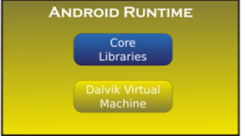
Architecture - Runtime
Set of core libraries to provide most of the functionality (Java)
Every application runs its own process
Executable format - .dex
Can run multiple VMs efficiently

Slide 13
Architecture – App Framework
Activity Manager – Manages the lifecycle of applications
Content Provider – Enable application access data from other apps
Resource Manager – Providing access to non-code resources
Window Manager – To manage windows displayed
Notification Manager – To manage notifications in the notification bar

Slide 14
Developer Tools Available
The Tools available for developing android apps
ADT Bundle (Recommended) [Eclipse + Android Plugin]
Android Plugin usage with existing IDE like Netbeans, Elcipse
Android Studio (Beta)

Slide 15
Languages needed!
XML – Front end (UI Designing)
Java – Back end (Performing Operations)

Slide 16
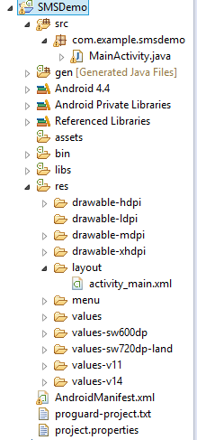
Breaking a project
Activity – Screens displayed (MainActivity.java)
Placing UI Controls (activity_main.xml)
Images used in the project – placed inside corresponding drawable folders

Slide 17
AndroidManifest.xml
<?xml version="1.0" encoding="utf-8"?>
<manifest xmlns:android="http://schemas.android.com/apk/res/android"
package="com.example.smsdemo"
android:versionCode="1"
android:versionName="1.0" >
<uses-sdk
android:minSdkVersion="8"
android:targetSdkVersion="18" />
<uses-permission android:name="android.permission.INTERNET"/>
<application
android:allowBackup="true"
android:icon="@drawable/ic_launcher"
android:label="@string/app_name"
android:theme="@style/AppTheme" >
<activity
android:name="com.example.smsdemo.MainActivity"
android:label="@string/app_name" >
<intent-filter>
<action android:name="android.intent.action.MAIN" />
<category android:name="android.intent.category.LAUNCHER" />
</intent-filter>
</activity>
</application>
</manifest>
All permissions required by the applications are set here
Basic controls of the app are mentioned here
Target SDK, min SDK (API Mentioned here)

Slide 18
XML Example
<LinearLayout xmlns:android="http://schemas.android.com/apk/res/android"
xmlns:tools="http://schemas.android.com/tools"
android:layout_width="match_parent"
android:layout_height="match_parent" >
<TextView
android:layout_width="wrap_content"
android:layout_height="wrap_content"
android:text="@string/hello_world" />
</LinearLayout>

Slide 19
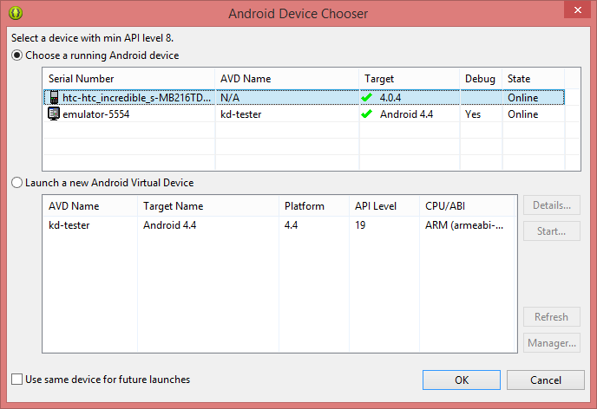
Executing the developed App
The developed app can be done in two ways:
In a real phone
Virtual Device

Slide 20
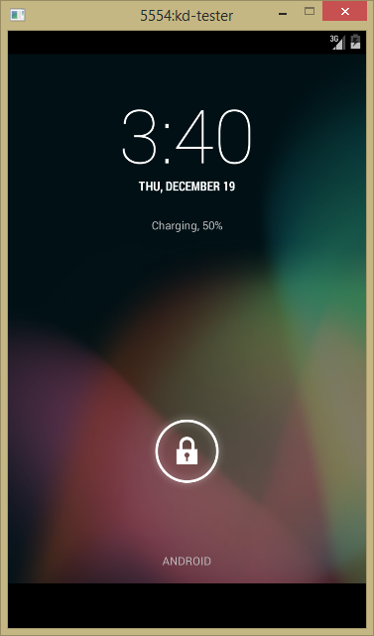
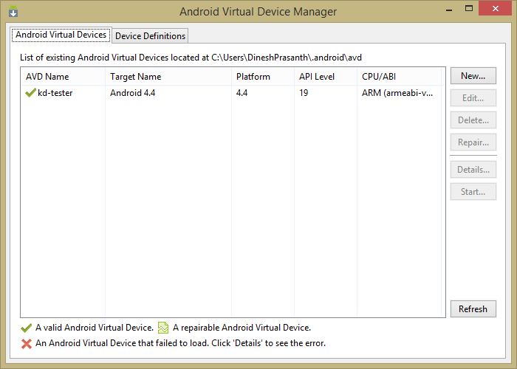
Emulator
It is a virtual Android device inside your PC!
Let’s you develop and test your android apps
It is a complete mobile phone with all the buttons and controls available

Slide 21
The Output in AVD!

Slide 22
Syntax
Declaration of UI
Button button = (Button) findViewById(R.id.button_send);
Operation on button
button.setOnClickListener
( new View.OnClickListener()
{
public void onClick(View v)
{ // Do something in response to button click
}
}
);

Slide 23
Input From user
1. using setText()
Ex:
tt.setText(Integer.toString(z));
2.using getText()
x=Integer.parseInt(amount1.getText().toString());
Display the message:
Toast msg = Toast.makeText(getBaseContext(),"You have clicked Button
1", Toast.LENGTH_LONG);
msg.show();

Slide 24
(Android Market)
One stop for all app collection
And more like Music, Magazines, Books, Movies, and Television programs
Also buy Hardware like Chromebooks, Google Nexus-branded mobile devices and accessories
50 billion+ downloads in Google Play Store as of June 2013

Slide 25
Publishing your app in Google Play Store
All you need is a Google Account + Wallet account activated + $25 (Rs. ~1600) [One Time FEE] + Some patience
State your description, add screenshots, add features and Best Logo
If you want your apps to be charged, need to setup Merchandise account
In App-Billing feature available for billing inside your app (Eg. Buying coins inside games / Unlocking features)

Slide 26
Apk File (Executable Format)
Apk is the extension of the executable file for android
It is similar to ZIP file.
It contains all files (logos, pics used, compiled java files, manifest, xml)
Java files are compiled and are .dex files and so codes are not able to be reverse engineered

Slide 27
Some Exciting day-to-day Apps
Music = Double Twist, Google Play Music
Video = MX Player
SMS = Go SMS
Launcher = Next Launcher

Slide 28
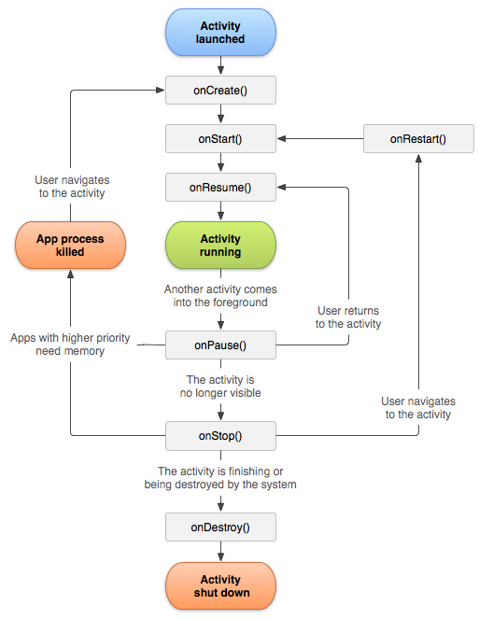
Android Life Cycle

Slide 29
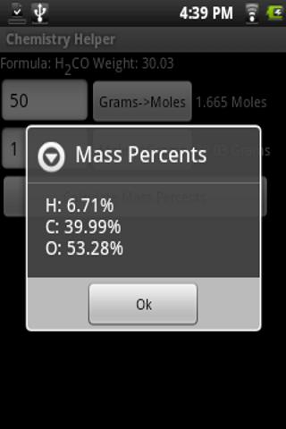
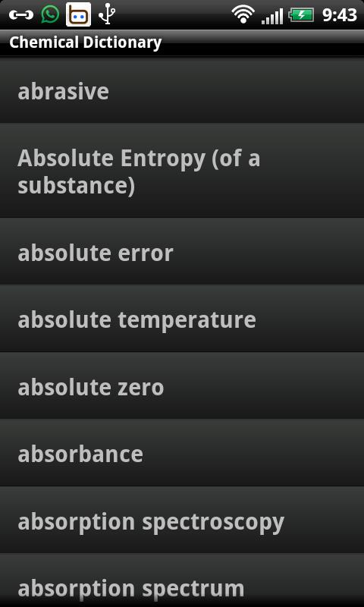
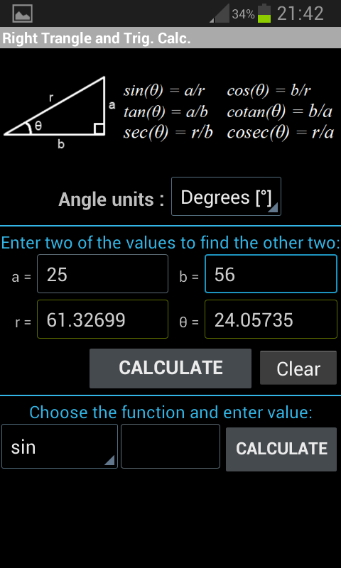
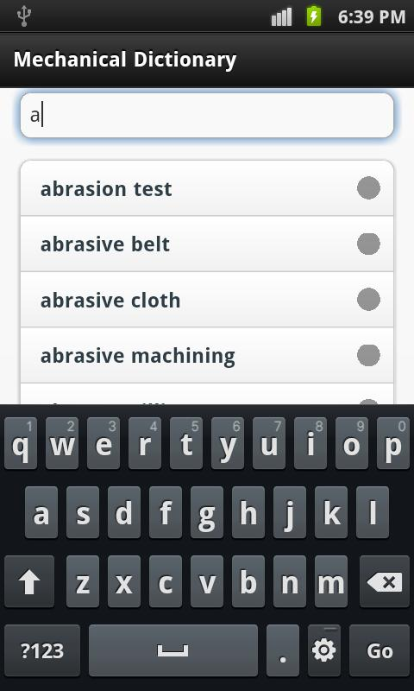
Android – Other streams
For Chem – Chemical Dictionary, Chemistry helper
For Mech– Mechanical Engineering Toolbox, Mechanical Dictionary

Slide 30
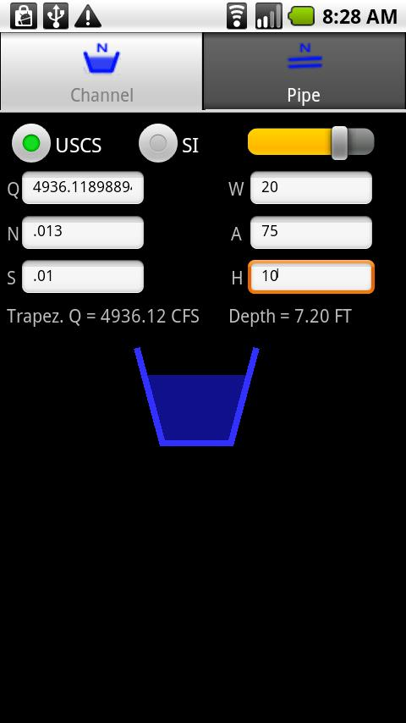
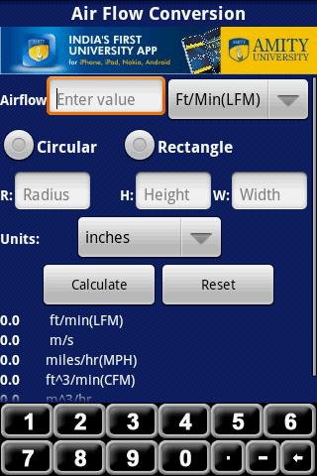
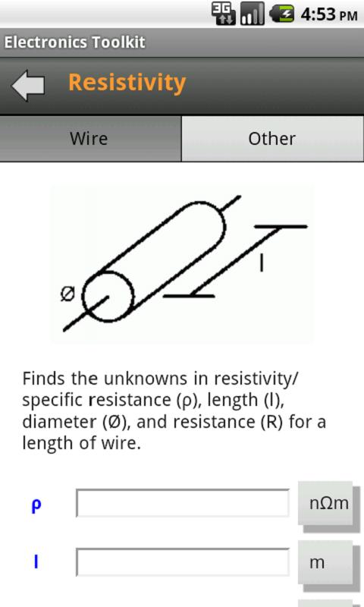
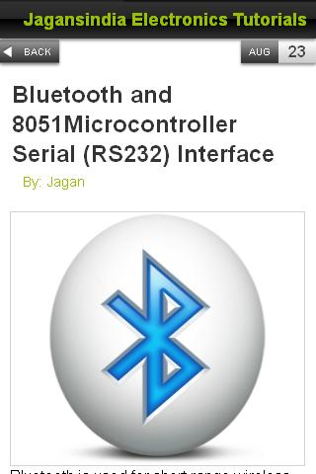
Android – Other Streams
For Civil – Civil Calculator, Civil Calculations
For Electronics – Electronics Toolkit, Electronics Tutorials

Slide 31
Apps developed by our students
Explore Erode
iWay SMS Controller
KEC GPA & CGPA

Slide 32
Some Advanced Info - ROOTING
To attain “ROOT ACCESS” with android subsystems
Similar to “Sudo” actions in linux environment
Allows to install, un-install new OS (Like Ubuntu, FireFox OS)
Allows to hard-install some apps inside your android phone
Requires to UNLOCK BOOTLOADER
May VOID warranty and may sometimes BRICK your phone!!
Careful handling and guide must be followed!!!
BEST CUSTOM ROM for Beginners: CyanogenMod

Slide 33
Using J2ME
Insecure
HTTP request-reply problem (same as for WAP)
Requires considerable software development
More difficult to deploy
Simple, intuitive, pleasing user interface possible
Very extendable

Slide 34
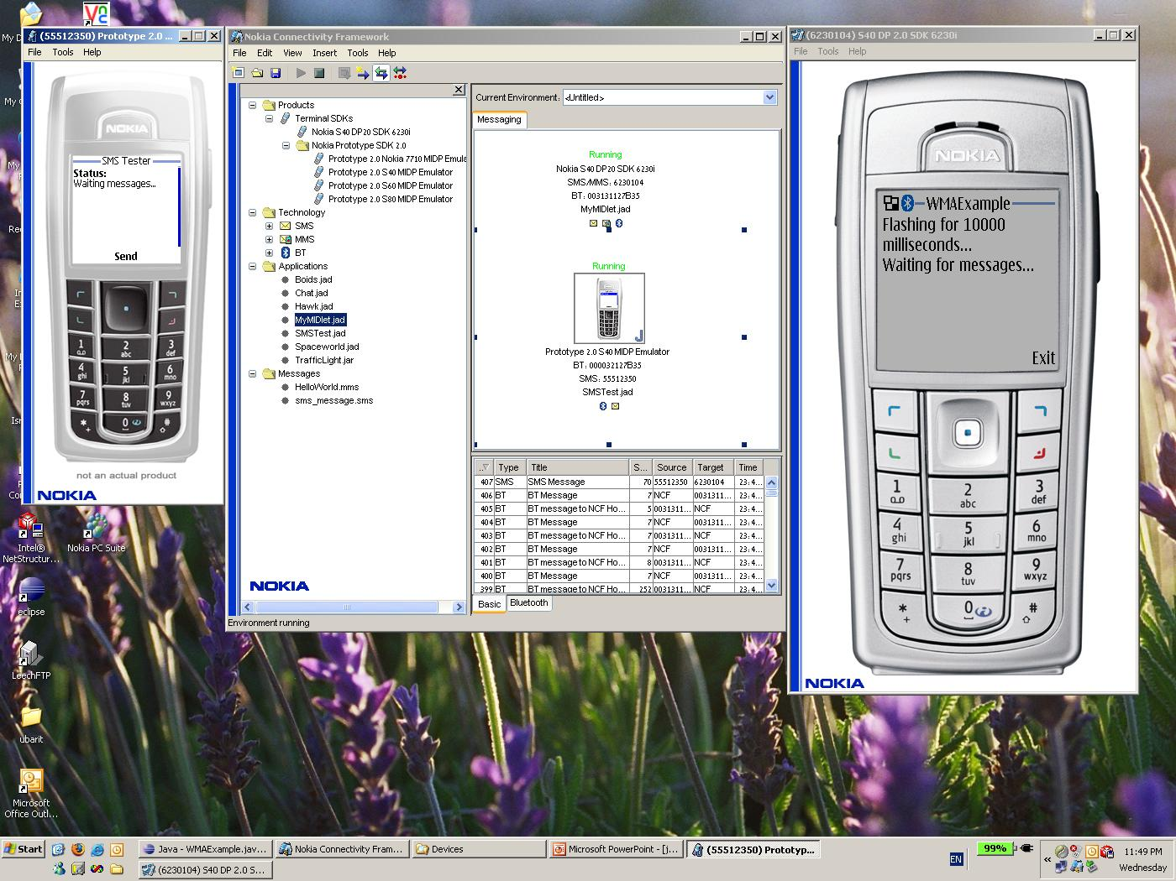

Slide 35
Mobile device Tools
Android (operating system)
Dalvik (software)
Java (programming language)

Slide 36
what mobile platform should I start learning?
Windows Mobile
C++ or .NET
free distribution, just like normal applications or through market
You need a Windows PC to develop
proprietary
Android
Java
Open Source
through Android Market ($25 one-time fees) or like normal applications
The platform is completely open source
iPhone
Objective-C or Java (Developing iPhone Applications using Java)
through iPhone Market ($99/year fees)
You need Mac (Mac OS) for development
proprietary
Java
J2ME or JavaFX
largely open source

Slide 37
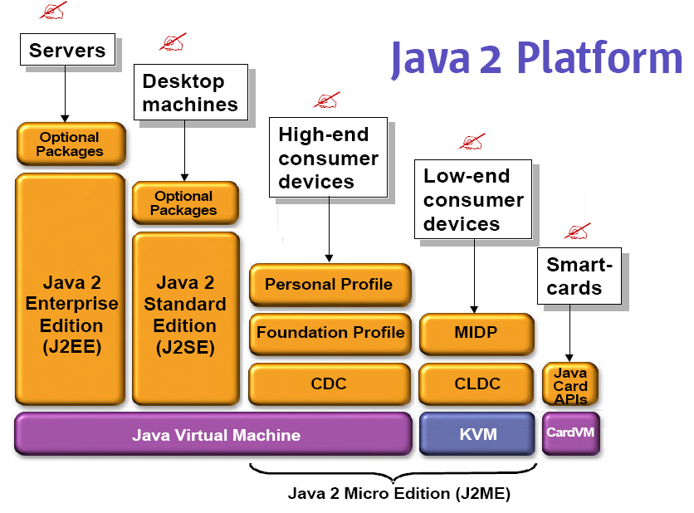
Java Family

Slide 38
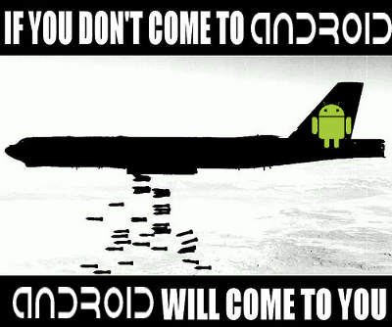
Thank You
Queries?

